Slide 1
– Web Client & Server Programming –
Introduction to JavaScript
CPNT 262
Web Client & Server Programming
Day 1
Introduction to JavaScript

Slide 2
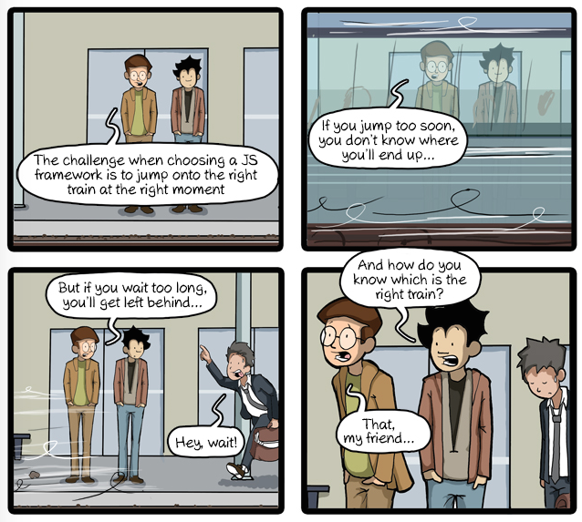
– Web Client & Server Programming –
Introduction to JavaScript

Slide 3
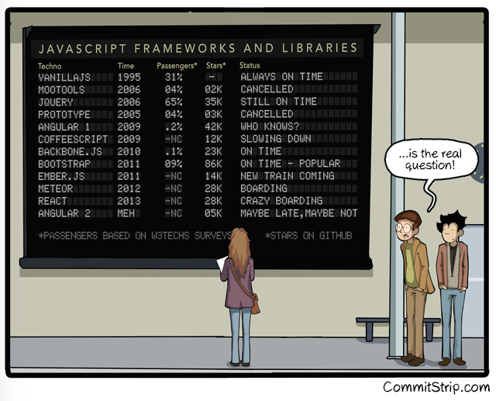

Slide 4
Please refer to the following sections in your textbook:
– Web Client & Server Programming –
Introduction to JavaScript
Beginning JavaScript, Fourth Edition by Paul Wilton and Jeremy McPeak:
Chapter 1 – Introduction to JavaScript and the Web
Chapter 2 – Data Types and Variables
Chapter 3 – Decisions, Loops, and Functions
Also worth reading:
Chapter 4 – Common Mistakes, Debugging, and Error Handling

Slide 5
Introduction
– Web Client & Server Programming –
Introduction to JavaScript
JavaScript trivia:
  JavaScript is not Java
  Started by Netscape as Mocha, later LiveScript
  Standardized by European Computer Manufacturer’s Association (ECMA)

Slide 6
Introduction
– Web Client & Server Programming –
Introduction to JavaScript
JavaScript trivia:
  Interpreted language
  Client-side JavaScript cannot be hidden from clients
  The sandbox:
    Cannot be used to open, read, write or save files to the client machine without permission
    Can write “cookies” to your hard drive

Slide 7
JavaScript Development Tools
Brackets - http://brackets.io
Sublime Text - http://www.sublime.com
Atom - https://atom.io/
IDE’s (Interactive Development Environments)
WebStorm IDE - https://www.jetbrains.com/webstorm/
Eclipse IDE – http://www.eclipse.org/downloads/packages/eclipse-ide-javascript-web-developers/indigosr2
NetBeans IDE - https://netbeans.org/

Slide 8
JavaScript Tools Continued
Browsers (all of them)
Debuggers (help you find your mistakes)
  Chrome (we’ll look at this in detail)
  IDE’s

Slide 9
Where do JavaScripts go?
– Web Client & Server Programming –
Introduction to JavaScript
  <script>
  // for the most part, inside <script> tags
  alert(“Hello World!”);
  </script>
  or
  <script>
  document.writeln(“<H1>Hello World!</H1>”);
  </script>
  or
  <a href=“#” onclick=“doSomeJavascript();”>My Link</a>

Slide 10
Where is JavaScript used?
– Web Client & Server Programming –
Introduction to JavaScript
Embedded in HTML using Script tag:
  <script type=“text/JavaScript”>
  JavaScript program goes here
  </script>
  Script tag can be in:
    <head> – insures that script loads before client can interact and alter site
    <body>
    both

Slide 11
Where is JavaScript used?
– Web Client & Server Programming –
Introduction to JavaScript
Inline – inside HTML tags:
  <input type=“submit” OnClick=“validate();” />
  or
  <a href=“#” onclick=“doSomeJavascript();”>My Link</a>

Slide 12
Where is JavaScript used?
– Web Client & Server Programming –
Introduction to JavaScript
External file:
  Remote:
<script type=‘text/JavaScript’ src=“http://someserver.com/filename.js”>
</script>
  Local:
<script type=‘text/JavaScript’ src=“filename.js”>
</script>
  file must end with .js

Slide 13
Syntax Fundamentals
– Web Client & Server Programming –
Introduction to JavaScript
Comments:
  // comments out to the end of the line
  /* */ comments out multi-line block
The Semicolon ‘;’
  Used to tell the end of a javascript ‘statement’ (the browser sees as statement as a sentence)

Slide 14
Syntax Fundamentals
– Web Client & Server Programming –
Introduction to JavaScript
Variable declaration statement:
  var variablename;
  var variablename = 10;
  var stringvariable = “value”;
  “var” is optional
  Paint the Page Red Exercise

Slide 15
Alert Boxes
Alert box
  alert(‘some message’);
Confirm box
  confirm(‘press a button’);
Prompt box
  prompt(‘Please enter your name’,’default’);
  JavaScript Flow Exercise

Slide 16
Fundamentals
– Web Client & Server Programming –
Introduction to JavaScript
Variables:
  Naming:
    Unlimited length
    Alphabet,numeric, _, $
    Can’t start with a numeric
    Case sensitive
Variable scope:
  Local if declared inside a function
  Global to entire HTML file if declared outside a function

Slide 17
Fundamentals
– Web Client & Server Programming –
Introduction to JavaScript
Variable types:
  Six data types defined by ECMA:
    Undefined
    Null
    String
    Number
    Boolean
    Object

Slide 18
Fundamentals
– Web Client & Server Programming –
Introduction to JavaScript
Unary operators:
  ++ – increment
  -- – decrement

Slide 19
Fundamentals
– Web Client & Server Programming –
Introduction to JavaScript
Binary operators:
  *
  /
  + (string & numeric)
  -
  %

Slide 20
Fundamentals
– Web Client & Server Programming –
Introduction to JavaScript
Relational operators:
  < – less than
  > – greater than
  >= – greater than or equal
  <= – less than or equal
  == – equal to
  != – not equal to

Slide 21
Fundamentals
– Web Client & Server Programming –
Introduction to JavaScript
Logical operators:
  Used for combining results of logical expressions:
    && – logical AND
    || – logical OR
    if (x==5 || x==10)
    if (x==5 && y==10)

Slide 22
Fundamentals
– Web Client & Server Programming –
Introduction to JavaScript
Assignment operators (the important ones):
  =
  +=
  -=
  *=
  /=
  %=

Slide 23
Fundamentals
– Web Client & Server Programming –
Introduction to JavaScript
Special values (similar to constants):
  NaN:
    Not a Number
  Null:
    Empty or non-existing
  Undefined:
    Variable has been declared but value has not been assigned
  true & false or 1 & 0:
    Boolean values

Slide 24
Events
Like ‘actions’ or ‘verbs’. Telling javascript to ‘do something’
Examples:
  onClick(doSomething);
  onMouseOut(doSomething);
  onMouseOver(doSomething);
  onSubmit(doSomething);
  onBlur(doSomething);
  onFocus(doSomething);

Slide 25
Fundamentals
– Web Client & Server Programming –
Introduction to JavaScript
If:
  if ( expression ) statement
  if ( expression ) statement else statement
  if (yourname == “”) document.write(“who are you?“);
  if (numberOfDaysUntilAssignmentDue > 1) {
  relax( );
  } else {
  panic( );
  workAllNight( );
  }

Slide 26
Fundamentals
– Web Client & Server Programming –
Introduction to JavaScript
While
    while (expression) {
    statement
    }
  while (daysUntilGraduation != 0)
  {
  doHomework( );
  --daysUntilGraduation;
  }

Slide 27
Fundamentals
– Web Client & Server Programming –
Introduction to JavaScript
For:
  for (expression1; expression2; expression3) {
  statement
  }
  for (i=0; i<10; i++)
  {
  processData();
  }

Slide 28
Exercise
– Web Client & Server Programming –
Introduction to JavaScript
Do the exercises in CPNT262 Exercise Day 1.doc.

